Slide 1
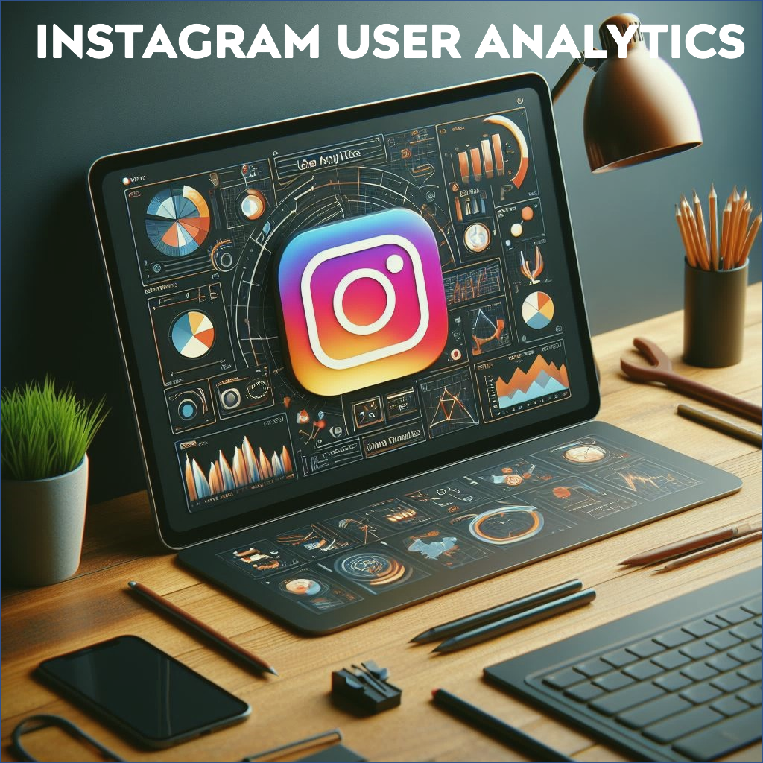
Created by Mainak Mukherjee | Email- subha.mainak@gmail.com

Slide 2

Project Description:-
The project involves extracting and analyzing data from an Instagram database.
Its aim is to understand Instagram user behavior and preferences.
It seeks insights into user interests, demographics, and engagement patterns.
The objective is to enhance content strategies, boost engagement, and optimize marketing efforts.
The findings could influence future developments on one of the world's leading social media platforms.

Slide 3
-| Approach |-
Data Exploration: Exploratory Data Analysis (EDA) is used to better understand user demographics, post frequency and interaction trends.
SQL Queries and Analysis: Utilizing SQL queries, I extracted relevant subsets of data from the database to address specific analytical questions.
Content Analysis: Analyzed the content of popular posts, including active users, inactive users, best days for engagement, loyal users, and prominent hashtags/captions.
Insights Generation: Through iterative analysis and interpretation of query results, I derived actionable insights regarding user behavior, content performance, and audience engagement.
Validation and Iteration: Iterative improvements were made to the analysis methodology based on feedback and emerging trends in the Instagram ecosystem.

Slide 4
-| Tech-Stack Used |-
For this project, I utilized the following software and versions:
MySQL Workbench 8.0 CE
MySQL Workbench was chosen as the primary tool for database development and management due to its user-friendly interface, robust query editor, and comprehensive features for database design and administration.
Version 8.0 CE was selected to leverage the latest enhancements, bug fixes, and performance optimizations available in the MySQL ecosystem.

Slide 5
-: Project Agenda :-
Marketing Analysis
Loyal User Reward: The marketing team wants to reward the most loyal users, i.e., those who have been using the platform for the longest time.
Inactive User Engagement: The team wants to encourage inactive users to start posting by sending them promotional emails.
Contest Winner Declaration: The team has organized a contest where the user with the most likes on a single photo wins.
Hashtag Research: A partner brand wants to know the most popular hashtags to use in their posts to reach the most people.
Ad Campaign Launch: The team wants to know the best day of the week to launch ads.
Investor Metrics
User Engagement: Investors want to know if users are still active and posting on Instagram or if they are making fewer posts.
Bots & Fake Accounts: Investors want to know if the platform is crowded with fake and dummy accounts.

Slide 6

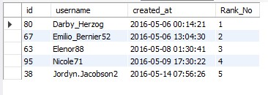
Task 1:- Identify the five oldest users on Instagram.
Query-
Insights:- The results clearly show that Darby Herzog, Emilio Bernier, Elenor, Nicole and Jordyn Jacobson are the oldest Instagram users, and so are eligible for the rewards.
Result-

Slide 7

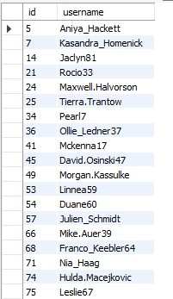
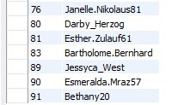
Task 2:- Identify users who have never posted a single photo on Instagram.
Query-
Insights:- The results clearly demonstrate that these 26 users have never posted a single photo on Instagram. Hence, they might be classified as inactive or less active users.
Result-

Slide 8
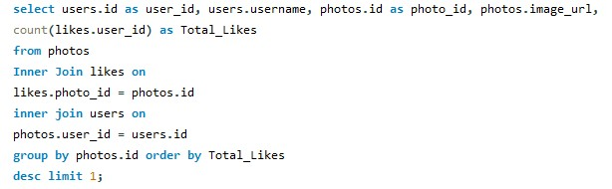

Task 3:- Determine the winner of the contest and provide details.
Query-
Insights:- From the output of this query it is clearly evident that Zack Kemmer is the winner of the contest since he has 48 likes on his Instagram post.
Result-

Slide 9
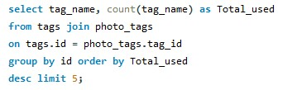
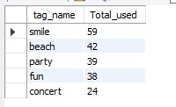
Task 4:- Identify and suggest the top five most commonly used hashtags on the platform.
Query-
Insights:- The result table indicates that top 5 most commonly used hashtags are- ‘#smile’ ‘#beach’ ‘#party’ ‘#fun’ & ‘#concert’
Result-

Slide 10


Task 5:- Determine the day of the week when most users register on Instagram.
Query-
Insights:- Based on the query output, Thursday and Sunday are the optimal days to run Ad Campaigns.
Result-

Slide 11
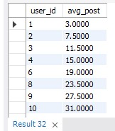


Task 6:- Calculate the average number of posts per user on Instagram. Also, provide the total number of photos on Instagram divided by the total number of users.
Result 1-
Query 1-
Query 2-
Insights:- On average, each user generates 2–3 posts on Instagram.
Result 2-

Slide 12
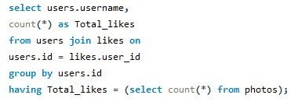
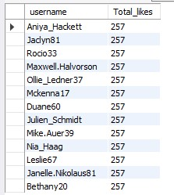
Task 7:- Identify users (potential bots) who have liked every single photo on the site.
Query-
Insights:- There are 13 fake accounts that like all Instagram posts, which might be categorized as potential bots.
Result-

Slide 13
THANK YOU

